Slide 1
Web Development Technology

Slide 2
Need of Subject
Web technology is the establishment and use of mechanisms that make it possible for different computers to communicate and share resources. Web technologies are infrastructural building blocks of any effective computer network: Local Area Network (LAN), Metropolitan Area Network (MAN) or a Wide Area Network (WAN), such as the Internet. Communication on a computer could never be as effective as they are without the plethora of web technologies in existence.

Slide 3
Web Technologies
1) Mark-up languages including HTML, CSS, XML, CGI and HTTP;
2) Programming Languages and Technologies which help in creating applications for the web; some of the languages are Perl, C#, Java and Visual Basic .Net;
3) Web servers and server technologies which facilitate request handling on a network where different users have to share the same resources and communicate with one another;
4) Databases, which are crucial for data and information storage on a computer network; and
5) Business applications customized for specific execution of tasks on a network.
In short, web technology provides a platform for effective communication among different users and devices on a computer network.
https://en.wikiversity.org/wiki/Web_Technologies_Master_List

Slide 4
INTRODUCTION TO HTML

Slide 5
HTML
HTML stands for Hyper Text Markup Language
Hyper Text: is text displayed on a computer display or other electronic devices with references (hyperlinks) to other text which the reader can immediately access, or where text can be revealed progressively at multiple levels of detail (also called StretchText).
Markup : Markup languages are designed for the processing, definition and presentation of text. The language specifies code for formatting, both the layout and style, within a text file. The code used to specify the formatting are called tags.
HTMLis a an example of a widely known and used markup language

Slide 6
IMPLEMENTATION
WHERE WE WRITE CODE :
1.Text Editor
1.Wordpad (In Windows OS)
2.Gedit Text Editor (Ubundu in LINUX)
2.FrontPage or Dreamweaver
WHERE WE EXECUTE :
1.Double Click that HTML File. (or)
2.Right click – Open With Internet Explorer

Slide 7
HTML Example
<!DOCTYPE html> <html> <head> <title>Page Title</title> </head> <body> <h1>My First Heading</h1> <p>My first paragraph.</p> </body> </html >

Slide 8
Example Explained
The DOCTYPE declaration defines the document type to be HTML
The text between <html> and </html> describes an HTML document
The text between <head> and </head> provides information about the document
The text between <title> and </title> provides a title for the document
The text between <body> and </body> describes the visible page content
The text between <h1> and </h1> describes a heading
The text between <p> and </p> describes a paragraph

Slide 9
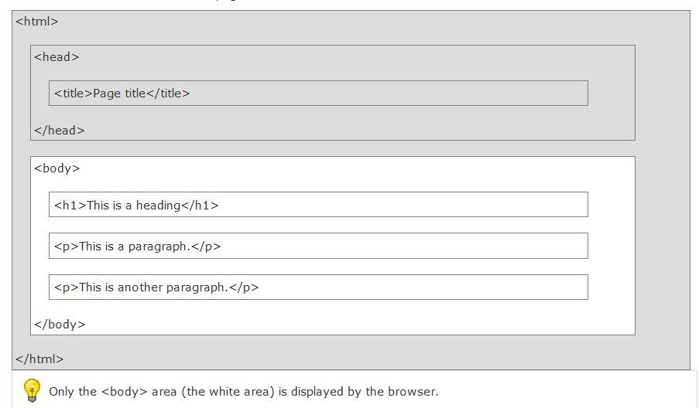
HTML Page Structure

Slide 10
HTML Tags
HTML tags are keywords (tag names) surrounded by angle brackets:
<tagname>content</tagname>
HTML tags normally come in pairs like <p> and </p>
The first tag in a pair is the start tag, the second tag is the end tag
The end tag is written like the start tag, but with a slash before the tag name

Slide 11
Link Tag
Html Links : Html links are defined with the <a> tag
Syntax : <a href="http://www.gmail.com">Gmail</a>
Example :
<html>
<body>
<a href="http://www.gmail.com">Gmail</a>
</body>
</html>
Gmail
If we click this link it goes to gmail account
O/P :

Slide 12

Image Tag
HTML Images :
HTML images are defined with the <img> tag.
Syntax : <img src "123.jpg" width="104" height="142" />
Example :
<html>
<body>
<img src="word.jpg" width="104" height="142" />
</body>
</html>
O/P:

Slide 13
HTML RULES
HTML Rules (Lines) :
The <hr /> tag is used to create an horizontal rule (line).
Example:
<html><body>
<h3>Exnora</h3>
<hr />
<h3>Safety Exnora</h3>
</body></html>
O/P :
Exnora
Safety Exnora

Slide 14
HTML COMMENTS
HTML Comments :
Comments can be inserted in the HTML code to make it more readable and understandable. Comments are ignored by the browser and are not displayed.
Syntax : <!-- some text →
Example :
<html><body>
<!--It will not be displayed-->
<h3>Plant Trees </h3>
</body></html>
O/P :
Plant Trees

Slide 15
HTML TEXT FORMATTING
Some Formatting Tags are 1.b-Bold, 2.i-Italic, 3.code-Computer code,4.sub-Subscript & 5.sup-Superscript
<html><body>
<b>Confidence</b><br />
<big>Hardwork</big><br />
<i>Preseverance</i><br />
<code>Samsung CRT</code><br />
This is<sub> subscript</sub><br />
This is<sup> superscript</sup>
</body></html>
Implement it as a Exercise
(Practical)

Slide 16
HTML STYLE ATTRIBUTES
Tags Description
<center> Defines centered content
<font> Defines HTML fonts
<s> and <strike> Defines strikeout text
<u> Defines underlined text
Attributes Description
Align Defines the alignment of text
Bgcolor Defines the background color
Color Defines the text color

Slide 17
STYLE EXAMPLE
<html>
<h1 style="text-align:center">NATURE</h1>
<body style="background-color:yellow">
<p style="font-family:Purisa;color:red">Plant Tree</p>
<p style="font-family:times;color:red">Save Our Generation</p>
<p style="font-size:40">Value Our Environment</p>
</body> </html>
NATURE
Plant Tree
Save Our Generation
Value Our Environment
O/P :

Slide 18
HTML TABLES
Tables are defined with the <table> tag.
A table is divided into rows (with the <tr> tag),
Each row is divided into data cells (with the <td> tag). The letters td stands for "table data," which is the content of a data cell.
Headings in a table are defined with the <th> tag.
<table border="1">
<tr> <td>row 1, cell 1</td>
<td>row 1, cell 2</td> </tr>
<tr> <td>row 2, cell 1</td>
<td>row 2, cell 2</td></tr>
</table>
row1,cell1
row1,cell2
row2,cell1
row2,cell2

Slide 19
TABLE FEATURES
1.Table with a caption :
<caption>My Caption</caption>
2.Table cells that span more than one row/column :
<th colspan="2">Telephone</th>
<th rowspan="2">Telephone:</th>
3.Cell padding :
<table border="1" cellpadding="10">
4.Cell spacing :
<table border="1" cellspacing="10">
5.Add a background color or a background image to a table :
<table border="1" bgcolor="red">

Slide 20
HTML LISTS
HTML supports ordered, unordered and definition lists.
Ordered Lists :
An ordered list is also a list of items. The list items are marked with numbers.
An ordered list starts with the <ol> tag. Each list item starts with the <li> tag.
Unordered Lists :
An unordered list is a list of items. The list items are marked with bullets (typically small black circles).
An unordered list starts with the <ul> tag. Each list item starts with the <li> tag.

Slide 21
Definition Lists :
A definition list is not a list of single items. It is a list of items (terms), with a description of each item (term).
A definition list starts with a <dl> tag (definition list).
Each term starts with a <dt> tag (definition term).
Each description starts with a <dd> tag (definition description).
Unordered List :
Think Positve
Never Depressed
Keep Smiling
Ordered List :
1.Fail
2.Work Hard
3.Win
4.Teach
Definition List :
Success
Fail First,
Happy
Smile Always

Slide 22
Unit 1
HTML

Slide 23
HTML
HTML stands for Hyper Text Markup Language, which is the most widely used language on Web to develop web pages.
HTML was created by Berners-Lee in late 1991 but "HTML 2.0" was the first standard HTML specification which was published in 1995. HTML 4.01 was a major version of HTML and it was published in late 1999. Though HTML 4.01 version is widely used but currently we are having HTML-5 version which is an extension to HTML 4.01, and this version was published in 2012.

Slide 24
HTML
HTML stands for Hypertext Markup Language, and it is the most widely used language to write Web Pages.
Hypertext refers to the way in which Web pages (HTML documents) are linked together. Thus the link available on a webpage are called Hypertext.
As its name suggests, HTML is a Markup Language which means you use HTML to simply "mark up" a text document with tags that tell a Web browser how to structure it to display.

Slide 25
Example
<!DOCTYPE html>
<html>
<head> <title>This is document title</title> </head>
<body> <h1>This is a heading</h1>
<p>Document content goes here.....</p>
</body>
</html>

Slide 26
Basic Tags
Heading Tags
Any document starts with a heading. You can use different sizes for your headings. HTML also has six levels of headings, which use the elements <h1>, <h2>, <h3>, <h4>, <h5>, and <h6>. While displaying any heading, browser adds one line before and one line after that heading.

Slide 27
Example
<!DOCTYPE html>
<html><head>
<title>Heading Example</title></head><body>
<h1>This is heading 1</h1>
<h2>This is heading 2</h2>
<h3>This is heading 3</h3>
<h4>This is heading 4</h4>
<h5>This is heading 5</h5>
<h6>This is heading 6</h6>
</body>
</html>

Slide 28
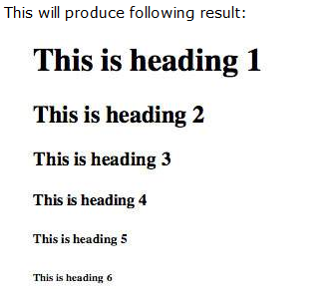

Slide 29
Paragraph Tag
The <p> tag offers a way to structure your text into different paragraphs. Each paragraph of text should go in between an opening <p> and a closing </p> tag.
<!DOCTYPE html>
<html>
<head>
<title>Paragraph Example</title></head>
<body><p>Here is a first paragraph of text.</p>
<p>Here is a second paragraph of text.</p>
<p>Here is a third paragraph of text.</p>
</body>
</html>

Slide 30
Output
Here is a first paragraph of text.
Here is a second paragraph of text.
Here is a third paragraph of text.

Slide 31
Line Break Tag
Whenever you use the <br /> element, anything following it starts from the next line. This tag is an example of an empty element, where you do not need opening and closing tags, as there is nothing to go in between them.
The <br /> tag has a space between the characters br and the forward slash. If you omit this space, older browsers will have trouble rendering the line break, while if you miss the forward slash character and just use <br> it is not valid in XHTML

Slide 32
Example
<!DOCTYPE html>
<html>
<head>
<title>Line Break Example</title>
</head>
<body><p>Hello<br />
You delivered your assignment ontime.<br />
Thanks<br />
Mahnaz</p>
</body>
</html>

Slide 33
Output
Hello
You delivered your assignment ontime.
Thanks
Mahnaz

Slide 34
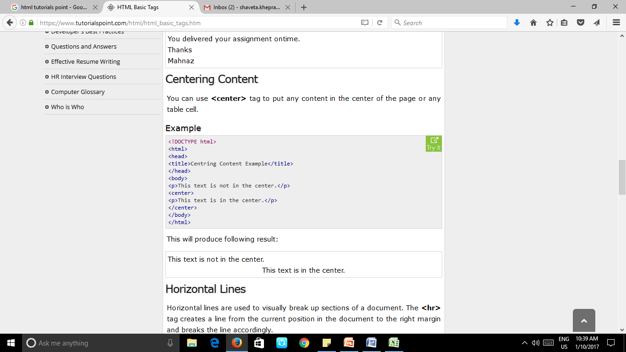
Centering Content
You can use <center> tag to put any content in the center of the page or any table cell.

Slide 35
Output
This text is not in the center.
This text is in the center.

Slide 36
Horizontal Lines
Horizontal lines are used to visually break up sections of a document. The <hr> tag creates a line from the current position in the document to the right margin and breaks the line accordingly.

Slide 37
Example
<!DOCTYPE html>
<html>
<head>
<title>Horizontal Line Example</title>
</head>
<body><p>This is paragraph one and should be on top</p>
<hr />
<p>This is paragraph two and should be at bottom</p>
</body>
</html>

Slide 38
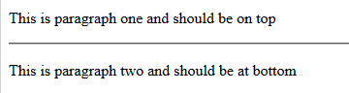
Output

Slide 39
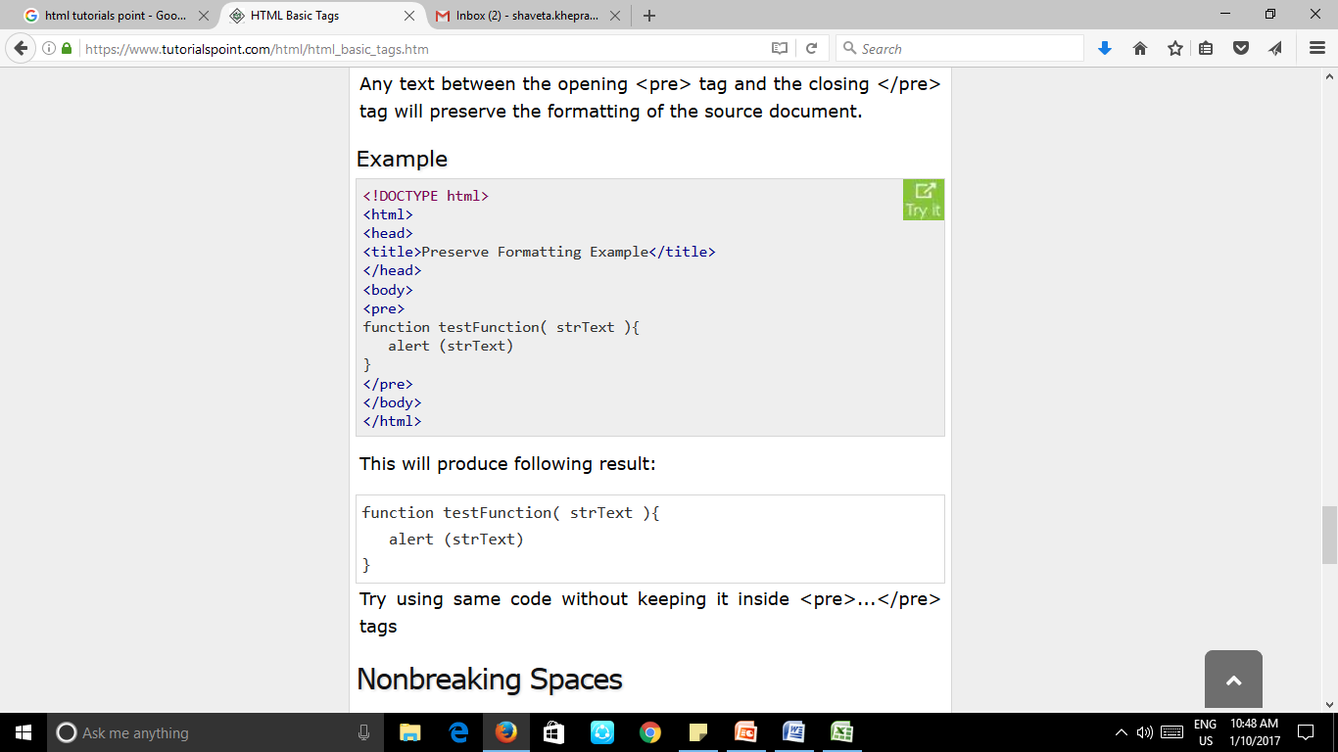
Preserve Formatting
Sometimes you want your text to follow the exact format of how it is written in the HTML document. In those cases, you can use the preformatted tag <pre>.
Any text between the opening <pre> tag and the closing </pre> tag will preserve the formatting of the source document.

Slide 40
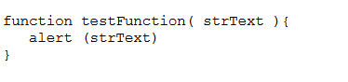
Output

Slide 41
Nonbreaking Spaces
Suppose you want to use the phrase "12 Angry Men." Here you would not want a browser to split the "12, Angry" and "Men" across two lines:
An example of this technique appears in the movie "12 Angry Men." In cases where you do not want the client browser to break text, you should use a nonbreaking space entity &nbsp; instead of a normal space.

Slide 42
Example
<!DOCTYPE html>
<html>
<head>
<title>Nonbreaking Spaces Example</title>
</head>
<body>
<p>An example of this technique appears in the movie "12&nbsp;Angry&nbsp;Men."</p>
</body>
</html>

Slide 43
Output
An example of this technique appears in the movie "12 Angry Men."

Slide 44
HTML Elements
An HTML element is defined by a starting tag. If the element contains other content, it ends with a closing tag, where the element name is preceded by a forward slash as shown below with few tags:
Start Tag | Content | End Tag
<p> | This is paragraph content. | </p>
<h1> | This is heading content. | </h1>
<div> | This is division content. | </div>
<br />
So here <p>....</p> is an HTML element, <h1>...</h1> is another HTML element. There are some HTML elements which don't need to be closed, such as <img.../>, <hr /> and <br /> elements. These are known as void elements.

Slide 45
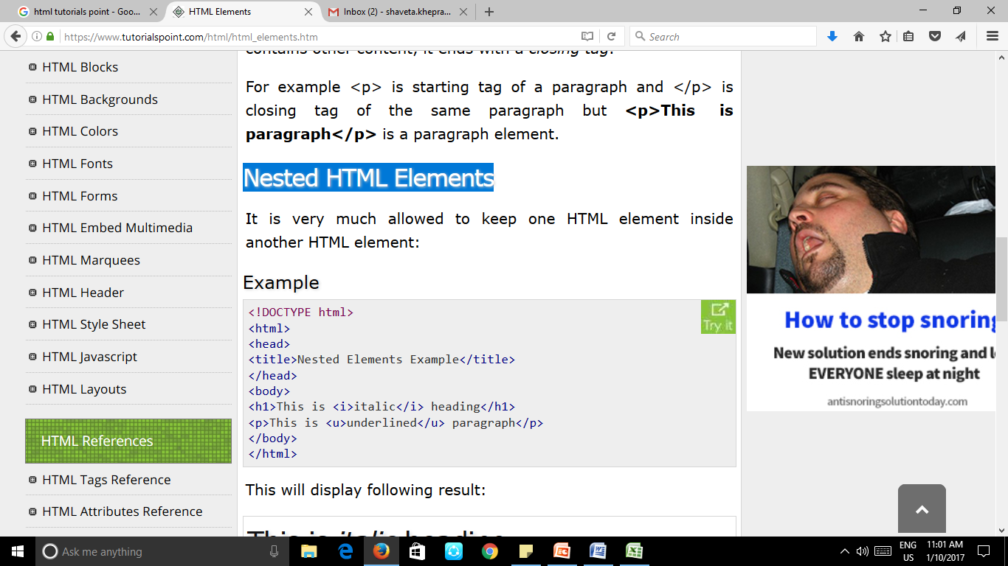
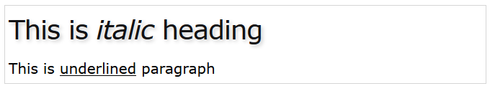
Nested HTML Elements

Slide 46
HTML Attributes
An attribute is used to define the characteristics of an HTML element and is placed inside the element's opening tag. All attributes are made up of two parts: a name and a value:
The name is the property you want to set. For example, the paragraph <p> element in the example carries an attribute whose name is align, which you can use to indicate the alignment of paragraph on the page.
The value is what you want the value of the property to be set and always put within quotations. The below example shows three possible values of align attribute: left, center and right.

Slide 47
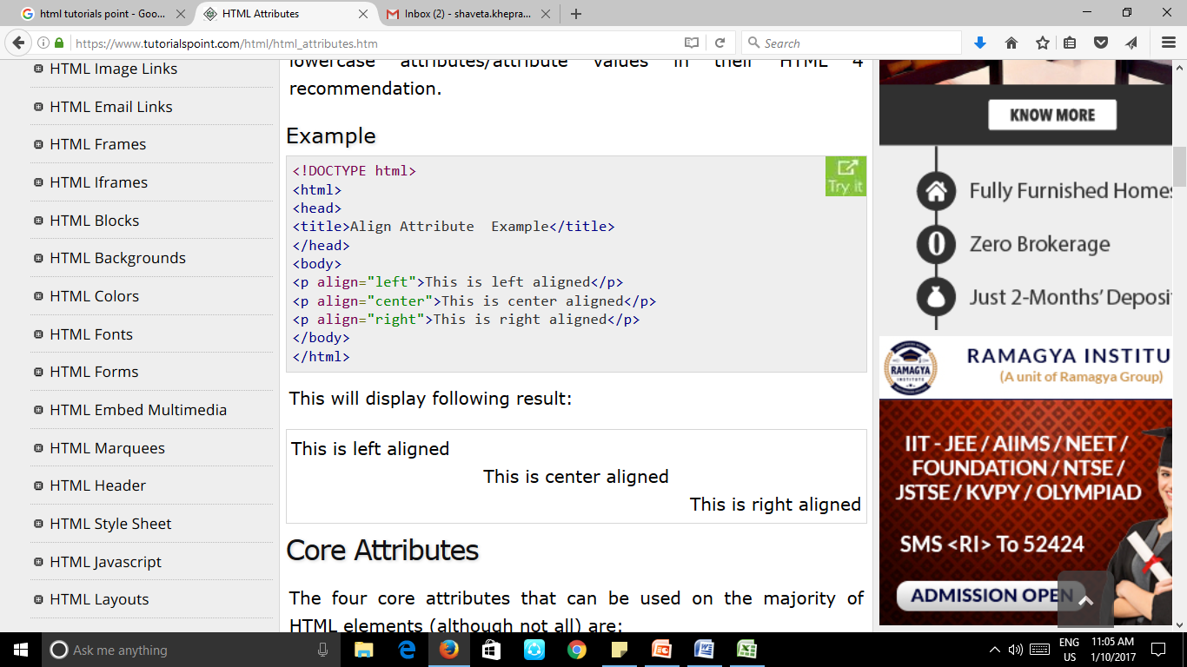
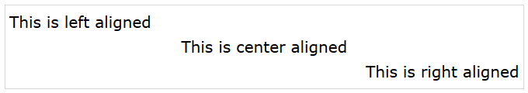

Slide 48
HTML Images
Insert Image: <img src="Image URL" ... attributes-list/>
Set Image Location
Set Image Width/Height: width= “150”, height =“150”
Set Image Border: border =“3”
Set Image Alignment: align=“right”

Slide 49
Example
<!DOCTYPE html>
<html>
<head>
<title>Set Image Alignment</title>
</head>
<body> <p>Setting image Alignment</p>
<img src="/html/images/test.png" alt="Test Image" border="3" width="150" height="100" align="right"/>
</body>
</html>

Slide 50
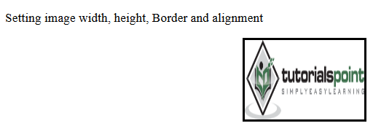
Output

Slide 51
HTML Text Links
A webpage can contain various links that take you directly to other pages and even specific parts of a given page. These links are known as hyperlinks.
Hyperlinks allow visitors to navigate between Web sites by clicking on words, phrases, and images. Thus you can create hyperlinks using text or images available on a webpage.

Slide 52
Linking Documents
A link is specified using HTML tag <a>. This tag is called anchor tag and anything between the opening <a> tag and the closing </a> tag becomes part of the link and a user can click that part to reach to the linked document.
Following is the simple syntax to use <a> tag.
<a href="Document URL" ... attributes-list>Link Text</a>

Slide 53
The target Attribute
This attribute is used to specify the location where linked document is opened. Following are possible options:
Option | Description
_blank | Opens the linked document in a new window or tab.
_self | Opens the linked document in the same frame.
_parent | Opens the linked document in the parent frame.
_top | Opens the linked document in the full body of the window.
targetframe | Opens the linked document in a named targetframe.

Slide 54
Example
<!DOCTYPE html>
<html>
<head>
<title>Hyperlink Example</title>
<base href="https://www.tutorialspoint.com/">
</head>
<body>
<p>Click any of the following links</p>
<a href="/html/index.htm" target="_blank">Opens in New</a> |
<a href="/html/index.htm" target="_self">Opens in Self</a> |
<a href="/html/index.htm" target="_parent">Opens in Parent</a> |
<a href="/html/index.htm" target="_top">Opens in Body</a>
</body>
</html>

Slide 55
Output
Click any of the following links
Opens in New | Opens in Self | Opens in Parent | Opens in Body

Slide 56
Use of Base Path
When you link HTML documents related to the same website, it is not required to give a complete URL for every link. You can get rid of it if you use <base> tag in your HTML document header. This tag is used to give a base path for all the links. So your browser will concatenate given relative path to this base path and will make a complete URL.

Slide 57
Example
<!DOCTYPE html>
<html>
<head>
<title>Base Tag Example</title>
<base href="https://www.tutorialspoint.com/">
</head>
<body>
<p>Click following link</p>
<a href="/html/index.htm" target="_blank">HTML Tutorial</a>
</body>
</html>
Now given URL <a href="/html/index.htm" is being considered as <a href="https://www.tutorialspoint.com/html/index.htm".

Slide 58
Setting Link Colors
You can set colors of your links, active links and visited links using link, alink and vlink attributes of <body> tag.
<!DOCTYPE html>
<html>
<head>
<title>Hyperlink Example</title>
<base href="https://www.tutorialspoint.com/"></head>
<body alink="#54A250" link="#040404" vlink="#F40633"><p>Click following link</p>
<a href="/html/index.htm" target="_blank" >HTML Tutorial</a>
</body>
</html>

Slide 59
HTML Image Links
<!DOCTYPE html>
<html>
<head>
<title>Image Hyperlink Example</title> </head>
<body>
<p>Click following link</p>
<a href="https://www.tutorialspoint.com" target="_self"> <img src="/images/logo.png" alt="Tutorials Point" border="0"/> </a>
</body></html>

Slide 60
HTML Tables
The HTML tables are created using the <table> tag in which the <tr> tag is used to create table rows and <td> tag is used to create data cells.
Example
<!DOCTYPE html>
<html>
<head> <title>HTML Tables</title></head>
<body>
<table border="1">
<tr>
<td>Row 1, Column 1</td>
<td>Row 1, Column 2</td>
</tr>
<tr>
<td>Row 2, Column 1</td>
<td>Row 2, Column 2</td>
</tr>
</table>
</body>
</html>

Slide 61
Output
Row 1, Column 1 | Row 1, Column 2
Row 2, Column 1 | Row 2, Column 2

Slide 62
Table Heading
<!DOCTYPE html>
<html>
<head>
<title>HTML Table Header</title>
</head>
<body><table border="1">
<tr>
<th>Name</th>
<th>Salary</th>
</tr>
<tr>
<td>Ramesh Raman</td>
<td>5000</td>
</tr>
<tr>
<td>Shabbir Hussein</td>
<td>7000</td>
</tr>
</table>
</body>
</html>

Slide 63
Output
Name | Salary
Ramesh Raman | 5000
Shabbir Hussein | 7000

Slide 64
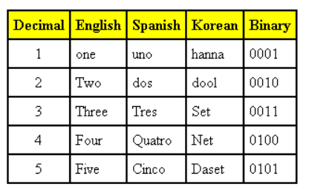
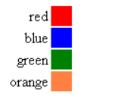
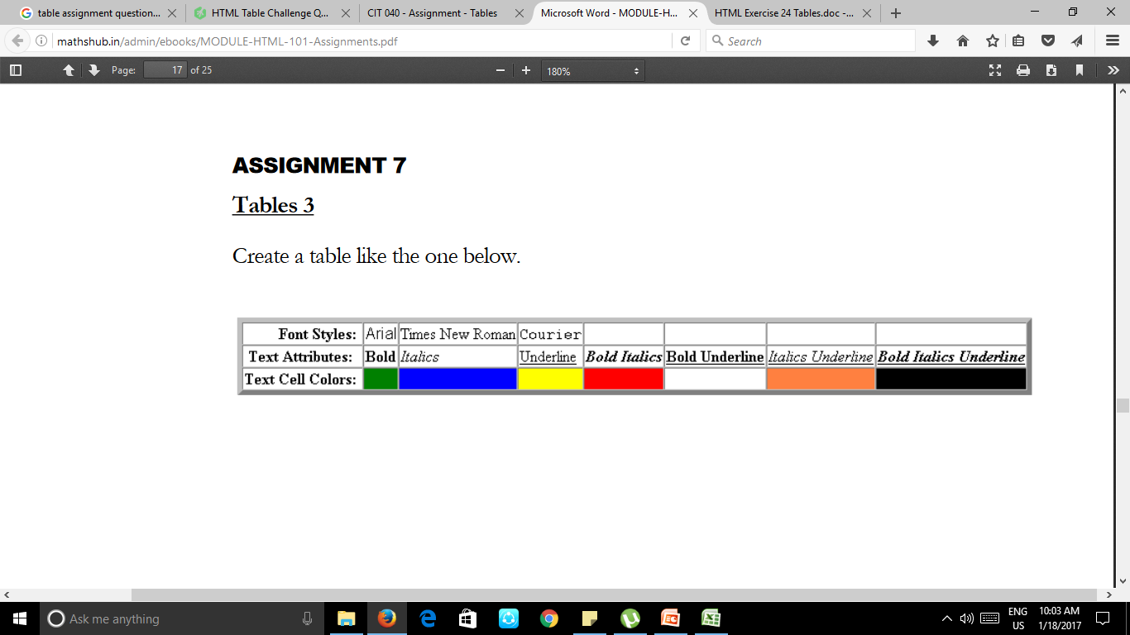
Assignment
Create Tables as below:

Slide 65
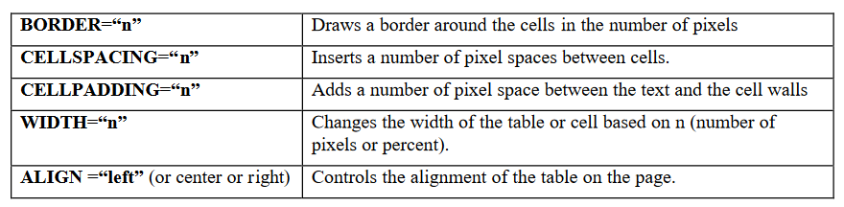
Other useful commands for Tables

Slide 66
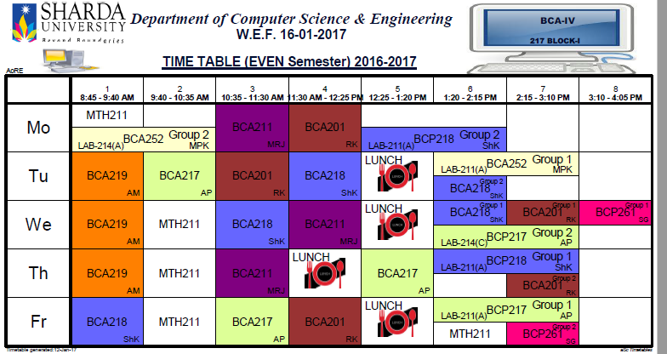

Slide 67
HTML Frames
HTML frames are used to divide your browser window into multiple sections where each section can load a separate HTML document. A collection of frames in the browser window is known as a frameset. The window is divided into frames in a similar way the tables are organized: into rows and columns.
Each HTML document is called a frame, and each frame is independent of the others.

Slide 68
Disadvantages of Frames
There are few drawbacks with using frames, so it's never recommended to use frames in your webpages:
Some smaller devices cannot cope with frames often because their screen is not big enough to be divided up.
Sometimes your page will be displayed differently on different computers due to different screen resolution.
The browser's back button might not work as the user hopes.
There are still few browsers that do not support frame technology.

Slide 69
Creating Frames
To use frames on a page we use <frameset> tag instead of <body> tag. The <frameset> tag defines how to divide the window into frames. The rows attribute of <frameset> tag defines horizontal frames and cols attribute defines vertical frames. Each frame is indicated by <frame> tag and it defines which HTML document shall open into the frame.

Slide 70
Example
<!DOCTYPE html>
<html>
<head>
<title>HTML Frames</title>
</head>
<frameset rows="10%,80%,10%">
<frame name="top" src="/html/top_frame.htm" />
<frame name="main" src="/html/main_frame.htm" />
<frame name="bottom" src="/html/bottom_frame.htm" />
<noframes>
<body> Your browser does not support frames. </body>
</noframes>
</frameset>
</html>

Slide 71
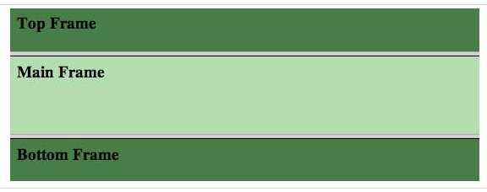
Output

Slide 72
<!DOCTYPE html>
<html>
<head>
<title>HTML Frames</title>
</head>
<frameset cols="25%,50%,25%">
<frame name="left" src="C:\Users\admin\Desktop\sharda\17-18\17-18\Web Design\HTML pages\top.jpg" />
<frame name="center" src="C:\Users\admin\Desktop\sharda\17-18\17-18\Web Design\HTML pages\main.png" />
<frame name="right" src="C:\Users\admin\Desktop\sharda\17-18\17-18\Web Design\HTML pages\bottom.jpg" />
<noframes>
<body> Your browser does not support frames. </body> </noframes>
</frameset>
</html> OUTPUT

Slide 73
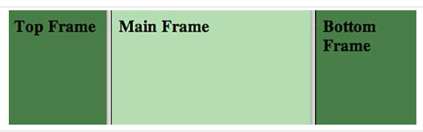
Output

Slide 74
The <frameset> Tag Attributes
Cols:
specifies how many columns are contained in the frameset and the size of each column. You can specify the width of each column in one of four ways: Absolute values in pixels.
For example to create three vertical frames, use cols="100, 500,100".
A percentage of the browser window. For example to create three vertical frames, use cols="10%, 80%,10%".
Using a wildcard symbol. For example to create three vertical frames, use cols="10%, *,10%". In this case wildcard takes remainder of the window.
As relative widths of the browser window. For example to create three vertical frames, use cols="3*,2*,1*". This is an alternative to percentages. You can use relative widths of the browser window.

Slide 75
rows
This attribute works just like the cols attribute and takes the same values, but it is used to specify the rows in the frameset.
For example to create two horizontal frames, use rows="10%, 90%". You can specify the height of each row in the same way as explained above for columns.

Slide 76
HTML div Tag
The HTML <div> tag is used for defining a section of your document. With the div tag, you can group large sections of HTML elements together and format them with CSS.

Slide 77
Example
<!DOCTYPE html>
<html>
<head>
<title>HTML div Tag</title>
<link rel="stylesheet" href="style2.css">
</head>
<body> <div id="contentinfo">
<p>Welcome to our website. We provide tutorials on various subjects.</p>
</div>
</body>
</html>

Slide 78
style2.css
#contentinfo p {
line-height: 20px;
margin: 30px;
padding-bottom: 20px;
text-align: justify;
width: 140px;
color: red;
}
Output

Slide 79
HTML - <span> Tag
The HTML <span> tag is used for grouping and applying styles to inline elements.
There is a difference between the span tag and the div tag. The span tag is used with inline elements whilst the div tag is used with block-level content.

Slide 80
Example
<!DOCTYPE html>
<html>
<head>
<title>HTML span Tag</title>
</head>
<body> <p>This is a paragraph <span style = "color:#FF0000;"> This is a paragraph</span>This is a paragraph</p>
<p><span style = "color:#8866ff;"> This is another paragraph</span></p>
</body> </html>

Slide 81
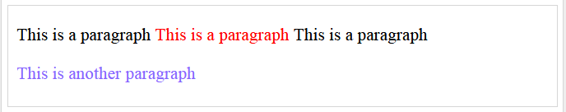

Slide 82
iframe
The <iframe> tag specifies an inline frame.
An inline frame is used to embed another document within the current HTML document.

Slide 83
Example
<!DOCTYPE html>
<html>
<head>
<title>HTML Iframes</title>
</head>
<body>
<p>Document content goes here...</p>
<iframe src = "https://www.tutorialspoint.com/index.htm" width = "100%"></iframe>
<p>Document content also go here...</p>
</body>
</html>
Output

Slide 84
DHTML
DHTML is NOT a language.
DHTML is a TERM describing the art of making dynamic and interactive web pages.
DHTML combines HTML, JavaScript, DOM, and CSS.

Slide 85
HTML <span> Tag
The HTML <span> tag is used for grouping and applying styles to inline elements.
There is a difference between the span tag and the div tag. The span tag is used with inline elements whilst the div tag is used with block-level content.

Slide 86
HTML FORMS
HTML Forms are used to collect user input.
A form is an area that can contain form elements.
Form elements are elements that allow the user to enter information like,
1. text fields,
2. textarea fields,
3. drop-down menus,
4. radio buttons,
5. checkboxes,
6. Action Attribute and the Submit Button,etc.

Slide 87
The <input> Element
The <input> element is the most important form element.
The <input> element has many variations, depending on the type attribute.
Type Description
text Defines normal text input
radio Defines radio button input (for selecting one of many choices)
submit Defines a submit button (for submitting the form)

Slide 88
TEXT INPUT
<input type="text"> defines a one-line input field for text input:
Example:
<form> First name:<br> <input type="text" name="firstname“><br> Last name:<br> <input type="text" name="lastname“></form>
First name :
Last name :

Slide 89
RADIO & CHECK BOX
Male
Female
Radio Buttons :
<form>
<input type="radio" name="sex" value="male" /> Male <br />
<input type="radio" name="sex" value="female" /> Female
</form>
Checkboxes :
<form>
Bike: <input type="checkbox" name="vehicle" value="Bike"/> <br />
Car: <input type="checkbox" name="vehicle" value="Car"/><br />
</form>
Bike
Car

Slide 90
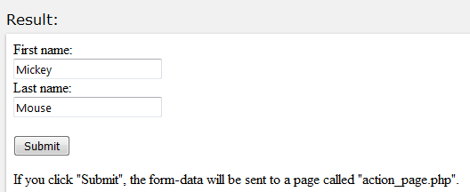
THE SUBMIT BUTTON
<input type="submit"> defines a button for submitting a form to a form-handler.
The form-handler is typically a server page with a script for processing input data.

Slide 91
Password
<form action="">
User name:<br>
<input type="text" name="userid">
<br>
User password:<br>
<input type="password" name="psw">
</form>
<p>The characters in a password field are masked (shown as asterisks or circles).</p>

Slide 92
Date
<form action="action_page.php">
Enter a date before 1980-01-01:<br>
<input type="date" name="bday" max="1979-12-31"><br><br>
Enter a date after 2000-01-01:<br>
<input type="date" name="bday" min="2000-01-02"><br><br>
<input type="submit">
</form>
<p><strong>Note:</strong>
type="date" is not supported in Internet Explorer.</p>

Slide 93
Color
<p>
Depending on browser support:<br>
A color picker can pop-up when you enter the input field.
</p>
<form action="action_page.php">
Select your favorite color:
<input type="color" name="favcolor" value="#ff0000">
<input type="submit">
</form>
<p><b>Note:</b> type="color" is not supported in Internet Explorer.</p>

Slide 94
Range
<p>
Depending on browser support:<br>
The input type "range" can be displayed as a slider control.
</p>
<form action="action_page.php" method="get">
Points:
<input type="range" name="points" min="0" max="10">
<input type="submit">
</form>
<p>
<b>Note:</b>
type="range" is not supported in Internet Explorer 9 and earlier versions.
</p>

Slide 95
Form Action Attribute
Action Attribute and the Submit Button :
When the user clicks on the "Submit" button, the content of the form is sent to the server.
The form's action attribute defines the name of the file to send the content to.
It depends on PHP File.
<form name="input" action="html_form_submit.asp" method="get">
Username:<input type="text" name="user"/>
<input type="submit" value="Submit" />
</form>
Username :
Submit

Slide 96
Name Attribute
To be submitted correctly, each input field must have a name attribute
Example:
<form action="action_page.php">
First name:<br>
<input type="text" value="Mickey“><br>
Last name:<br>
<input type="text" name="lastname" value="Mouse“><br><br>
<input type="submit" value="Submit“></form>
<p>If you click "Submit", the form-data will be sent to a page called "action_page.php".</p>
<p>The first name will not be submitted, because the input element does not have a name attribute.</p>

Slide 97
Result:
The first name will not be submitted, because the input element does not have a name attribute.

Slide 98
The <select> Element (Drop-DownList)
<form action="action_page.php">
<select name="cars">
<option value="volvo">Volvo</option>
<option value="saab">Saab</option>
<option value="fiat">Fiat</option>
<option value="audi">Audi</option>
</select>
<br><br>
<input type="submit">
</form>

Slide 99
The <textarea> Element
<form action="action_page.php">
<textarea name="message" rows="10" cols="30">
The cat was playing in the garden.
</textarea>
<br><br>
<input type="submit">
</form>

Slide 100
The <button> Element
<button type="button" onclick="alert('Hello World!')">Click Me!</button>

Slide 101
HTML LAYOUT
A part of this page is formatted with two columns, like a newspaper page.
The trick is to use a table without borders, and maybe a little extra cell-padding.
No matter how much text you add to this page, it will stay inside its column borders.

Slide 102
<table border="0" width="100%" cellpadding="10">
<tr>
<td width="50%" valign="top">
This is the Time to save Our Earth to Our Future Generation. So everybody should be a Volunteer.
</td>
<td width="50%" valign="top">
For smooth relationship between to us & nature We should do some activities to Preserve our Earth.
</td>
</tr> </table>
This is the Time to save Our Earth to Our Future Generation. So everybody should be a Volunteer.
For smooth relationship between to us & nature We should do some activities to Preserve our Earth.

Slide 103
HTML Input Attributes
Value
Readonly
Disabled
Size
Maxlength

Slide 104
Value
<form action=""> First name:<br> <input type="text" name="firstname" value="John"> <br> Last name:<br> <input type="text" name="lastname"> </form>

Slide 105
Readonly
<form action=""> First name:<br> <input type="text" name="firstname" value="John" readonly> <br> Last name:<br> <input type="text" name="lastname"> </form>

Slide 106
Disabled
<form action=""> First name:<br> <input type="text" name="firstname" value="John" disabled> <br> Last name:<br> <input type="text" name="lastname"> </form>

Slide 107
Size
<form action=""> First name:<br> <input type="text" name="firstname" value="John" size="40"> <br> Last name:<br> <input type="text" name="lastname"> </form>

Slide 108
Maxlength
<form action=""> First name:<br> <input type="text" name="firstname" maxlength="10"> <br> Last name:<br> <input type="text" name="lastname"> </form>

